Slide 1
Inner Classes
Qurratulain Malik qmalik@keyin.com

Slide 2
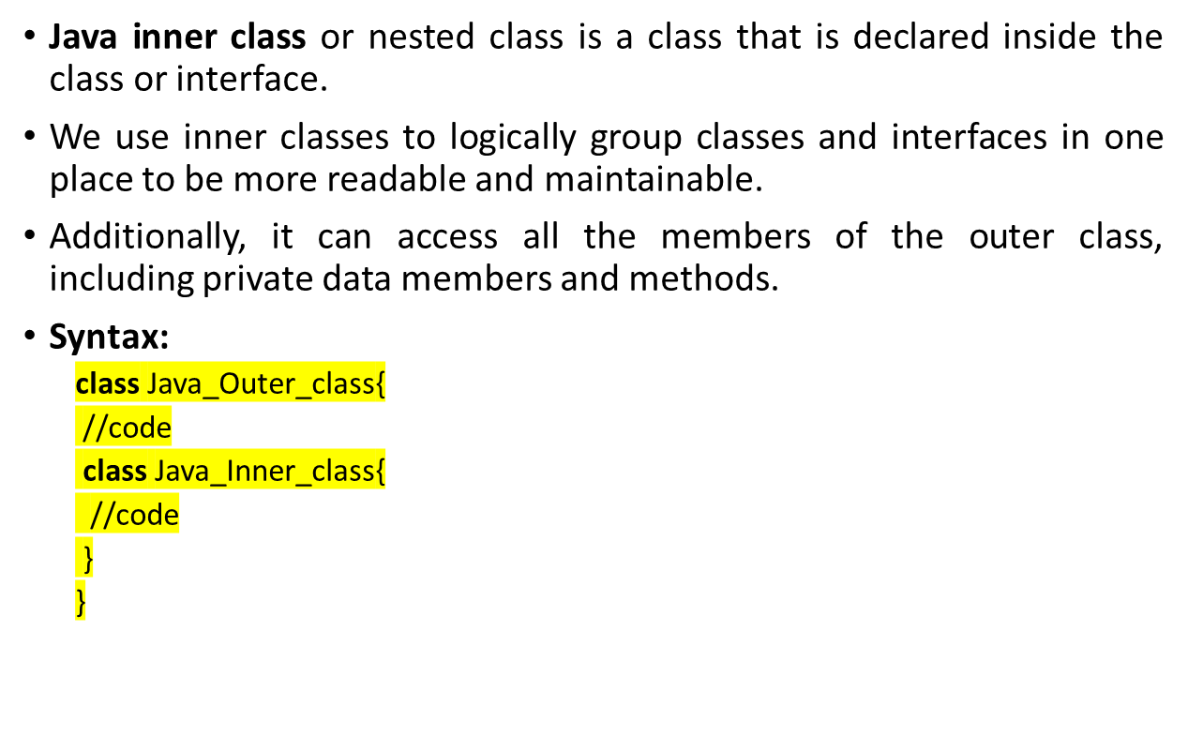
Inner classes

Slide 3
Simple Uses of Inner Classes
Inner (or nested) classes are classes defined within other classes:
  The class that includes the inner class is called the outer class
There are basically four types of inner classes in java.
    Nested Inner Class (public, private, Static)
    Static Nested Classes
    Method Local Inner Classes
    Anonymous Inner Classes

Slide 4
Simple Uses of Inner Classes (Cont’d)
An inner class definition is a member of the outer class in the same way that the instance variables and methods of the outer class are members.
  An inner class is local to the outer class definition.
  The name of an inner class may be reused for something else outside the outer class definition.
  If the inner class is private, then the inner class cannot be accessed by name outside the definition of the outer class.
There are two main advantages to inner classes
  They can make the outer class more self-contained since they are defined inside a class.
  Both of their methods have access to each other's private methods and instance variables.
Using an inner class as a helping class is one of the most useful applications of inner classes.
  If used as a helping class, an inner class should be marked private.

Slide 5
Tip: Inner and Outer Classes Have Access to Each Other's Private Members (as with GUIs)
Within the definition of a method of an inner class:
  It is legal to reference a private instance variable of the outer class
  It is legal to invoke a private method of the outer class.
Within the definition of a method of the outer class:
  It is legal to reference a private instance variable of the inner class on an object of the inner class.
  It is legal to invoke a (non-static) method of the inner class as long as an object of the inner class is used as a calling object.
Within the definition of the inner or outer classes, the modifiers public and private are equivalent.

Slide 6
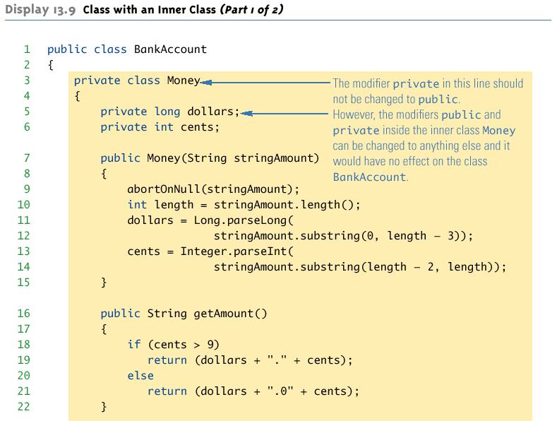
Inner Class: An Example

Slide 7
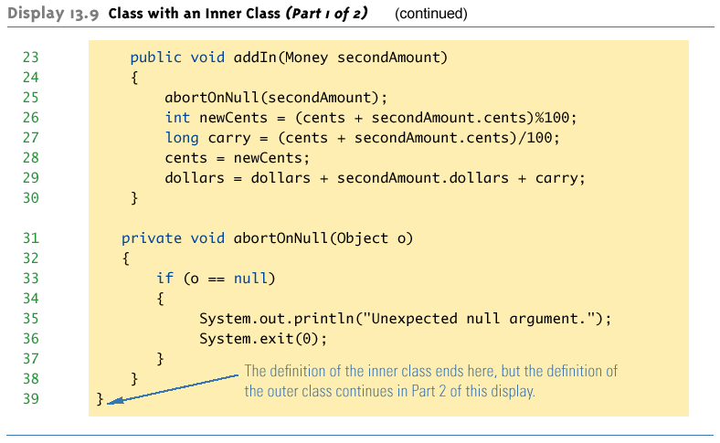
1. Nested Inner Class: An Example (Cont’d)

Slide 8
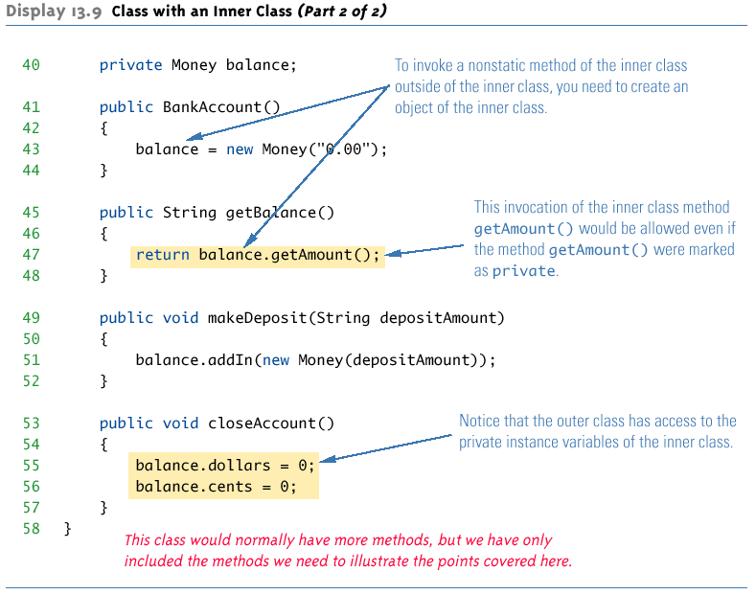
Inner Class: An Example (Cont’d)

Slide 9
Public Inner Classes
If an inner class is marked public, then it can be used outside of the outer class
In the case of a non-static inner class, it must be created using an object of the outer class
    BankAccount account = new BankAccount();
    BankAccount.Money amount = account.new Money("41.99");
  Note that the prefix account. must come before new

Slide 10
The .class File for an Inner Class
Compiling any class in Java produces a .class file named ClassName.class
Compiling a class with one (or more) inner classes causes both (or more) classes to be compiled, and produces two (or more) .class files
  Such as ClassName.class and ClassName$InnerClassName.class

Slide 11
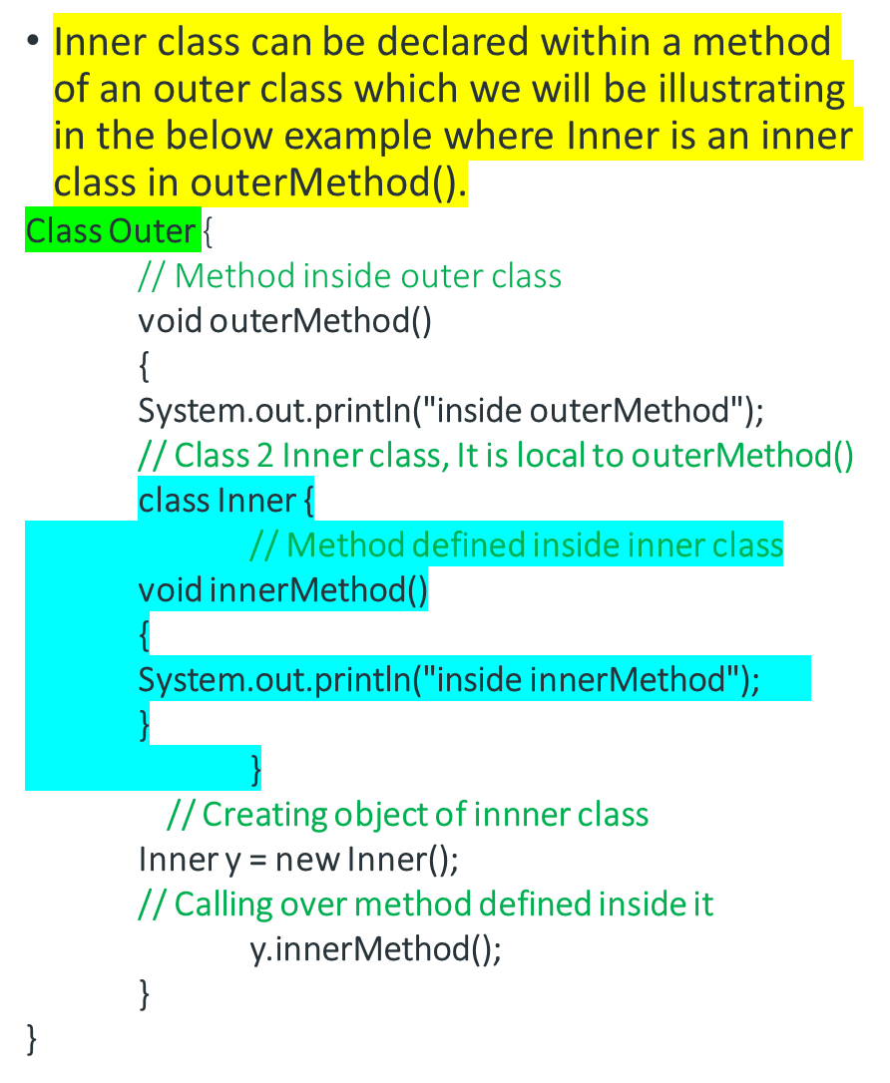
2. Method Local Inner Classes
Output
inside outerMethod
inside innerMethod
// Main class
class GFG {
public static void main(String[] args)
{
// Creating object of outer class inside main
Outer x = new Outer();
// Calling over the same method
// as we did for inner class above
x.outerMethod();
}
}

Slide 12
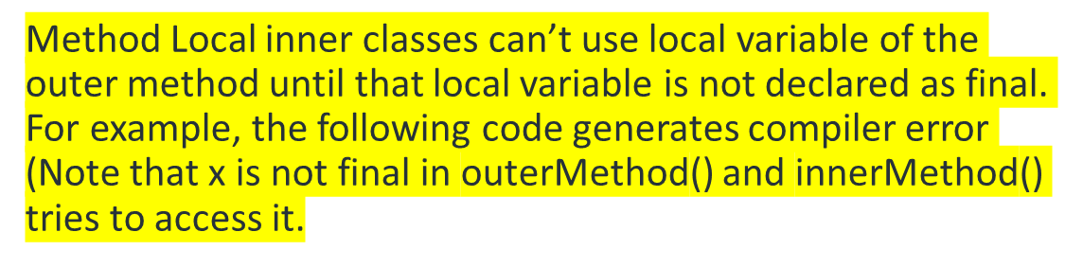
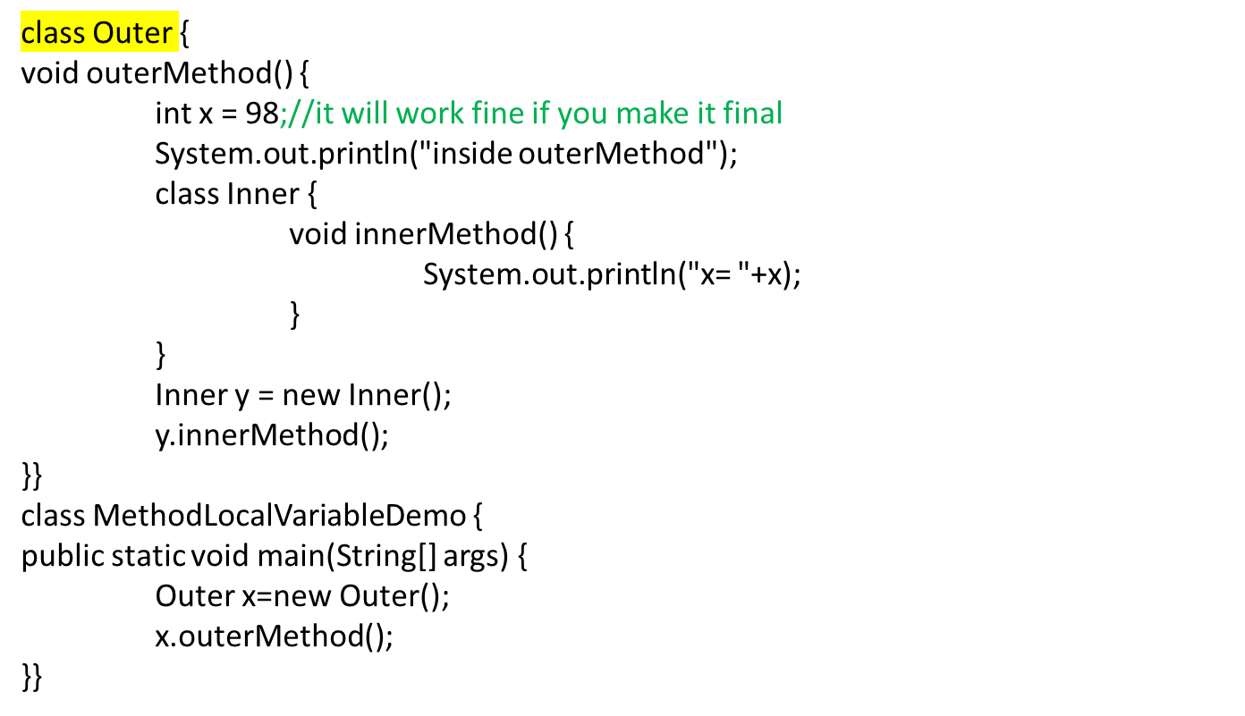
Method Local Inner Classes (Cont.)

Slide 13
3. Static Inner Classes
Static nested classes are not technically inner classes. They are like a static member of outer class.
A normal inner class has a connection between its objects and the outer class object that created the inner class object.
  This allows an inner class definition to reference an instance variable, or invoke a method of the outer class.
There are certain situations, however, when an inner class must be static.
  If an object of the inner class is created within a static method of the outer class.
  If the inner class must have static members.

Slide 14
Static Inner Classes (Cont’d)
Since a static inner class has no connection to an object of the outer class, within an inner class method:
  Instance variables of the outer class cannot be referenced.
  Non-static methods of the outer class cannot be invoked.
To invoke a static method or to name a static variable of a static inner class within the outer class, preface each with the name of the inner class and a dot.

Slide 15
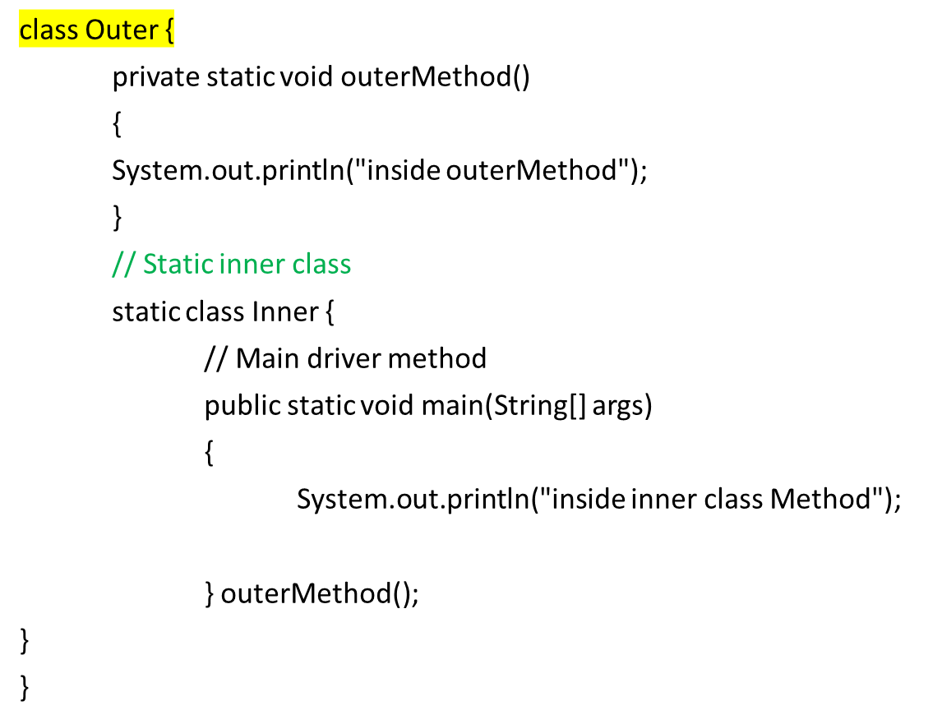
Static Inner Class Example
Output:
inside inner class Method
inside outerMethod

Slide 16
Public Inner Classes (Cont’d)
In the case of a static inner class, the procedure is similar to, but simpler than, that for non-static inner classes:
OuterClass.InnerClass innerObject =
    new OuterClass.InnerClass();
  Note that all of the following are acceptable
    innerObject.nonstaticMethod();
    innerObject.staticMethod();
    OuterClass.InnerClass.staticMethod();

Slide 17
Tip: Referring to a Method of the Outer Class
If a method is invoked in an inner class
  If the inner class has no such method, then it is assumed to be an invocation of the method of that name in the outer class.
  If both the inner and outer class have a method with the same name, then it is assumed to be an invocation of the method in the inner class.
  If both the inner and outer class have a method with the same name, and the intent is to invoke the method in the outer class, then the following invocation must be used:
    OuterClassName.this.methodName()
  using this inside an inner class refers to the object of the inner class.

Slide 18
4. Anonymous Inner Classes
An inner class declared without a class name is known as an anonymous inner class. In case of anonymous inner classes, we declare and instantiate them at the same time. Generally, they are used whenever you need to override the method of a class or an interface.
The syntax of an anonymous inner class is as follows −
  AnonymousInner an_inner = new AnonymousInner() {
  public void my_method() {
  ........
  ........
  }
  };

Slide 19
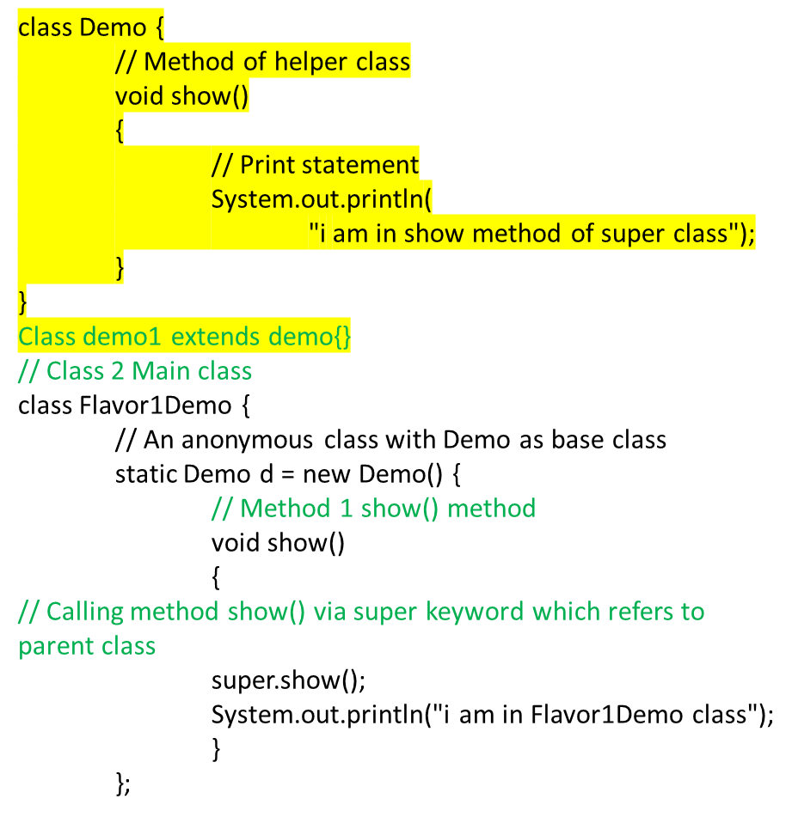
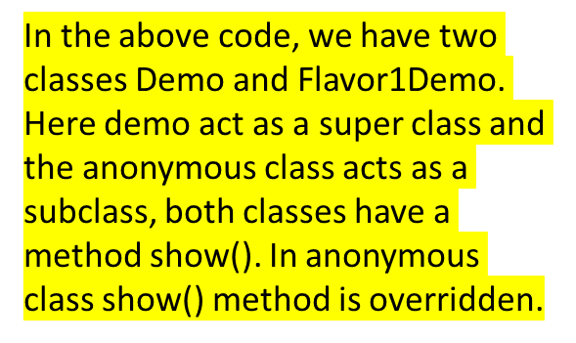
Way 1: As a subclass of the specified type
// Method 2 Main driver method
public static void main(String[] args)
{
// Calling show() inside main()
d.show();
}
}
Output
i am in show method of super class
i am in Flavor1Demo class

